Slide 1
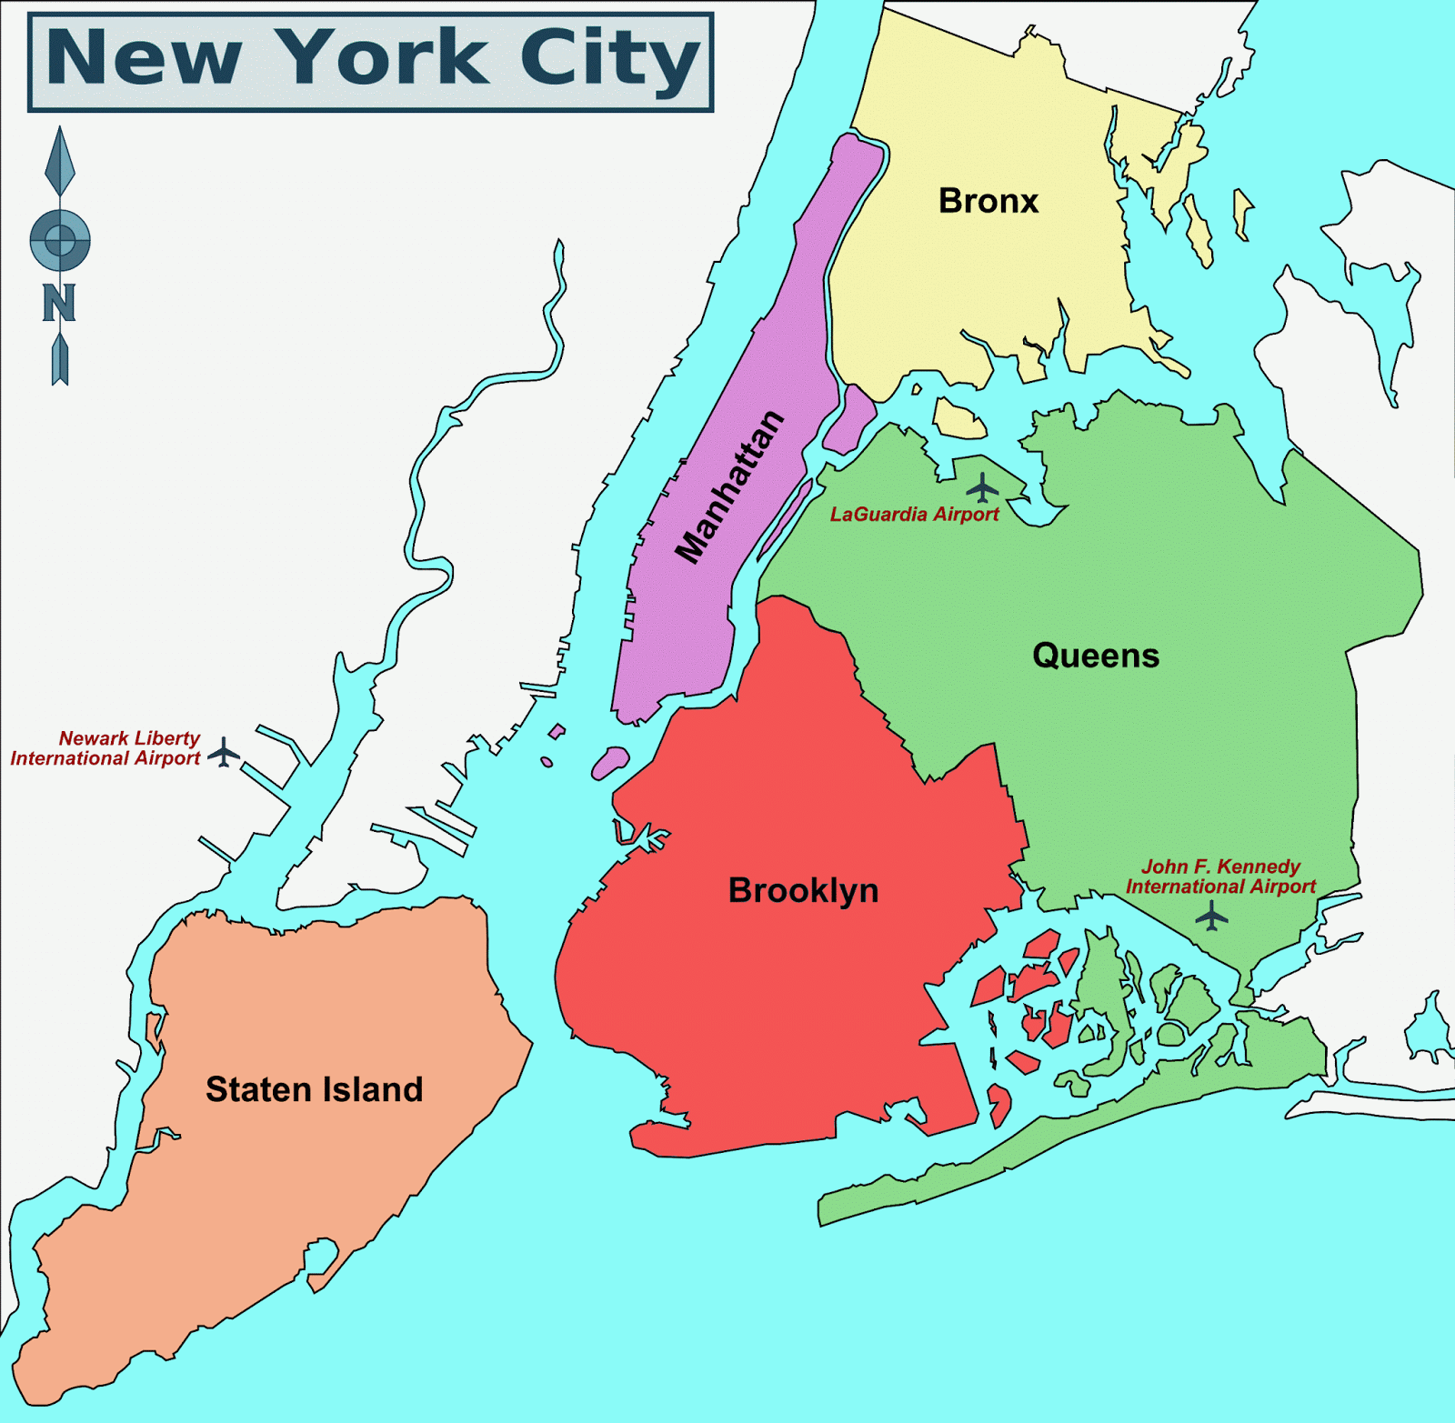
The Battle Of Neighbourhoods
This Photo by Unknown Author is licensed under CC BY-SA-NC

Slide 2
INTRODUCTION
Running a Restaurant is a high Profitable business with considerable low investment after the Initial setup of the business is completed. To Start the aforementioned business there are lot of factors to be consider starting with the investors, capital and including the location factors, geological attributes, population density and Competitors. All these factors when analysed carefully yields in good profits for the business as they show direct effect on the profit/Loss scale.
New York is the most populated city in the in United States and Largest borough by population in New York is Brooklyn. This city has a lot of sectors consisting of people from all over and World spreading across various industries. This City has a lot of immigrants from various parts of the World. This shows that there are huge types of cuisines one can offer in the restaurant business. This city even has people from various native languages and there are many restaurants present in New York including India, Chinese, Italian Etc. Opening a Restaurant here is a good profitable business by carefully analysing the above-mentioned factors. The general initial factors is to knowing the type of restaurant we are willing to start and to know the audience of that particulate classification. Then to determine the location considering the geological and economic factors. Next step is to identify the potential threats to the business such as Competitors, Low Minimum Wage, Increasing Food Prices, Healthier Choices For Customers. Considering all the factors lets analyse Mumbai to open a restaurant for good profits New York has 5 Boroughs and among them there are total of 59 Community Boards

Slide 3
INTRODUCTION
The factors we need to find can be the following
1. What type of customers we need to attract based the cuisine we offer (Target Audience)
2. What are the best locations to start the business as to yield good profits?
3. What are the other similar types of restaurants that might affect our business model (Potential Competitors)?

Slide 4
DATA SECTION
The below Wikipedia Page has the Details of the different neighborhoods of New York.
https://en.wikipedia.org/wiki/Neighborhoods_in_New_York_City
It has the information of each community Board, it's corresponding borough and details such as area, population Density Etc.
The Population Density in any area has a considerable amount of impact on the profit/Loss of the Restaurant in that area.
--------------------------------------------------------------------------------------------------------------------------------------------------------
The below Page has the Details of the different neighborhoods of New York.
https://cocl.us/new_york_dataset
This Data set also has the information different borough's and the boundaries in NYC
--------------------------------------------------------------------------------------------------------------------------------------------------------
The below Page has the Details of the different and popular foods around each borough of New YOrk city
https://en.wikipedia.org/wiki/Cuisine_of_New_York_City
This Data set also has the information Popular Food items in/around NYC

Slide 5
DATA SECTION
The below Page has various types of open data regarding the New York City.
https://data.cityofnewyork.us/
We Select the file Borough Boundaries.
This Dataset has the information of Boundaries and the Geospacial locations of different borough's in NYC. This data will help us in Visualization on Folium Maps which is used for different scenarios while exploring the Data
--------------------------------------------------------------------------------------------------------------------------------------------------------
The below URL is for the Foursquare site
https://foursquare.com/
This Site provides various API calls to Explore the Locations near by or any popular venues in the given Location
--------------------------------------------------------------------------------------------------------------------------------------------------------

Slide 6
METHODOLOGY
The Analysis part must focus on the Most popular food around each Borough and decide where the restaurant is to be installed.
1. We will collect the borough information and statistics from the Wikipedia Page
2. Then We will collect the popular food items in the boroughs of the NY city
3. The By using Foursquare API we will find the best restaurants in NYC based on the popular food Items
4. And find the Locations where the Restaurants serving the popular food are not abundant
5. By using the Data lets Visualize the restaurants and the popularity to conclude the best place to Start our Restaurant

Slide 7
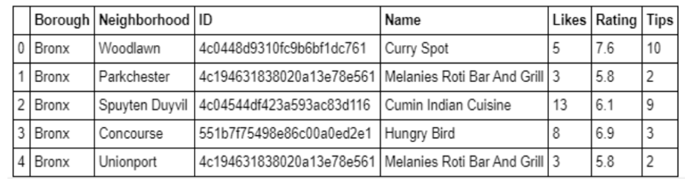
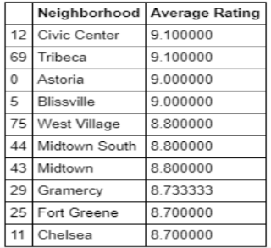
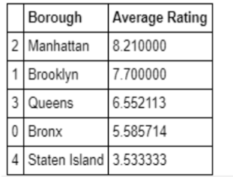
RESULTS

Slide 8
RESULTS
By Assessing the Highest ratings and the least ratings of the Different restaurants around the Neighbourhoods we see that Manhattan has the average rating of the restaurants as highest.
The Restaurant average rating in Staten Island is Least among all the borough’s
The Restaurant can earn good ratings if we follow the above analysed

Slide 9
Conclusion
So now we can answer the problems we need to know to open a restaurant in NYC.
From our analysis we can conclude the following Points
• Manhattan have potential Indian Restaurant Market
• Staten Island ranks last in average rating of Restaurants
• Manhattan is the best place to stay if you prefer to Start a Restaurant

